Slide 1
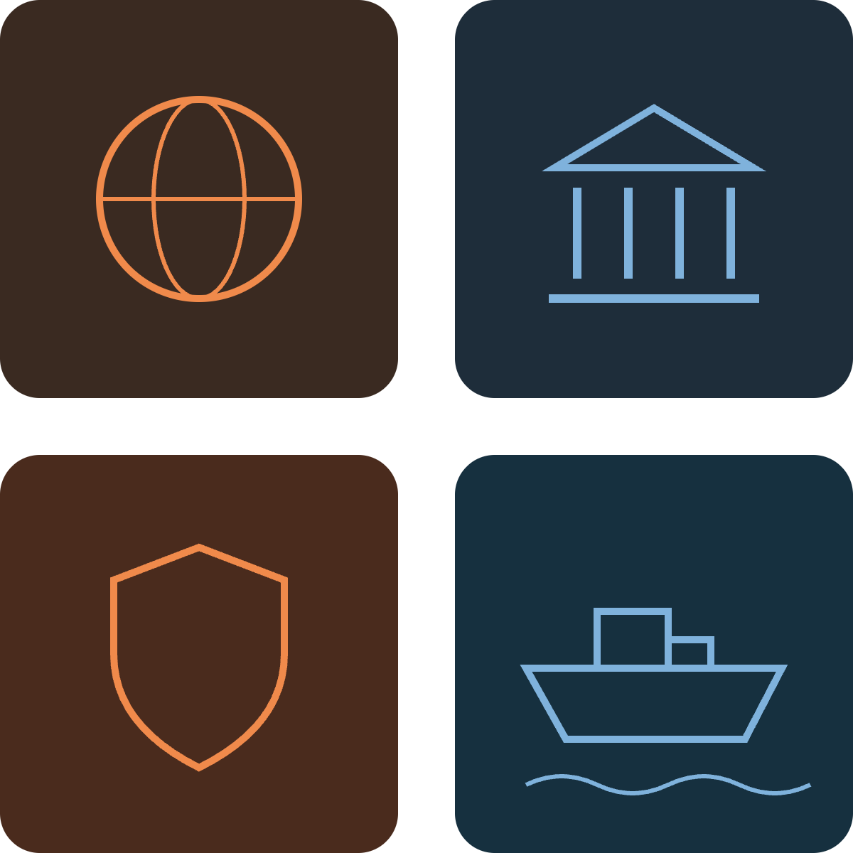
WEEK 3 · SCENARIO ANALYSIS
Supply Chain
& Logistics
Who runs the networks that move the world's goods, and what happens to them if global relations break down? Four futures from a 2x2 scenario analysis.
Team: Penn, Kerry, Steven, Sichen
Notes:
Open with the two questions that define our axes. First, who controls logistics: private companies or governments? Second, do global relations stay in check or spiral? 2026 already gives us live evidence on both: the Strait of Hormuz has been largely blocked since February, and the U.S. Postal Service is under real financial and privatization pressure. We use a 2x2 scenario analysis to map four futures and then find problems that matter in more than one of them.

Slide 2
The domain: supply chain & logistics
The networks that move goods from raw material to doorstep: shipping, ports, trucking, warehousing and parcel delivery. Two open questions now shape the whole system: who controls the network, and whether the routes stay open.
Chokepoint traffic vs. pre-crisis normal
80%
of world goods trade by volume travels by sea, so every chokepoint is a lever on the global economy
Share of usual traffic still moving through each route
Pre-crisis normal
100%
Suez Canal, 2025 (tonnage vs. 2023)
95%
of dry shipping containers are made in China, along with 70% of ship-to-shore port cranes
~30%
Strait of Hormuz, Aug. 2026 (ships/day)
~5%
cut by Amazon from its USPS contract, the Postal Service's largest. Amazon now out-ships USPS in parcels
20%
Hormuz went from 100+ vessels a day to about 5. Ships detouring around the Cape of Good Hope add 10–14 days to Asia–Europe trips.
Sources: UNCTAD, Review of Maritime Transport 2025 · Al Jazeera, Aug. 2026 · GoFreight, Jul. 2026 · Foundation for Defense of Democracies, Sep. 2026 · Phenomenal World, May 2026, citing ShipMatrix
Notes:
Define the domain broadly: everything that physically moves goods. Then the tension. Physical trade is concentrated in a few sea lanes, and in 2026 two of them are badly constrained: Suez is running about 70% below 2023 tonnage, and Hormuz traffic has collapsed by roughly 95% since the Iran war began on February 28. The right column sets up our two axes. Geopolitics: most trade moves by sea, and the equipment itself mostly comes from China. Ownership: the public carrier, USPS, is losing ground to a private one, Amazon.

Slide 3
Choosing the axes
Tool: 2x2 scenario analysis. Each axis is a critical uncertainty (high impact, unresolved today) pushed to its extreme in both directions. Crossing them gives four futures to stress-test.
AXIS 1 · OWNERSHIP
AXIS 2 · GLOBAL RELATIONS
Who runs logistics?
Do relations hold?
Fully private
Government-operated
Stay in check
Spiral out of control
Pulling private
Pulling toward a spiral
Amazon now out-ships USPS in parcels
USPS near its borrowing cap; privatization talk revived
Hormuz blocked since Feb. 2026, traffic down ~95%
U.S.–Iran conflict spreading to Iraq and Yemen
Pulling government
Pulling toward stability
U.S. Navy escorting merchant ships through Hormuz
Beijing demands a COSCO majority in the $23B ports sale
CMA CGM back in the Red Sea under naval escort
Shippers diversifying routes to absorb shocks
Why these two work together: they are independent. Private carriers can operate in a war zone, and governments can run logistics in peacetime, so all four corners are plausible.
Sources: Phenomenal World, May 2026 · Brookings, Mar. 2026 · Congressional Research Service, Aug. 2026 · Global Trade Magazine, Dec. 2025 · Al Jazeera, Aug. 2026 · GoFreight, Jul. 2026 · UNCTAD RMT 2025
Notes:
This is our tools-and-techniques slide. Scenario analysis starts by picking two critical uncertainties: things that would change the industry a lot and that could genuinely go either way. We push each to its extreme. The key check is independence. If the axes were correlated, two quadrants would be implausible. Here they are not: private security firms and carriers already operate in conflict zones, and many countries run state rail and post in peacetime. Note that the evidence today pulls both ways on ownership, and mostly toward the spiral on relations.

Slide 4
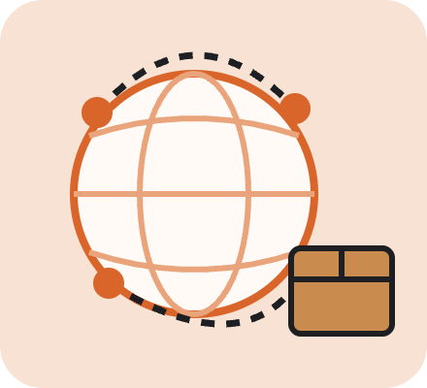

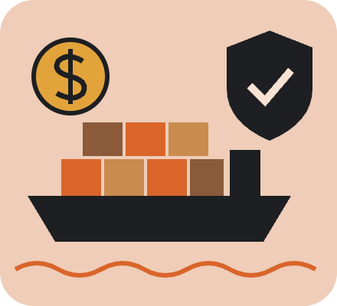
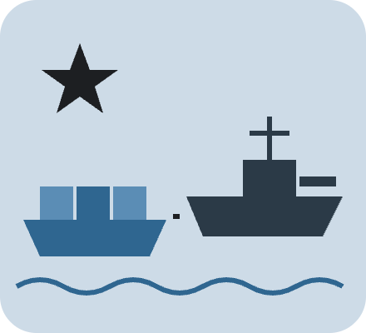
Four futures for logistics
Where 2026 sits: sliding toward the bottom row as chokepoints close, with ownership pulled both ways.
Privatization of logistics
← FULLY PRIVATE
GOVERNMENT-OPERATED →
Frictionless Marketplace
Public Utility Freight
Mega-platforms run end to end: lowest cost, fastest delivery
Routes that don't pay get dropped: rural, small, remote
Risk: private monopoly over essential infrastructure
Freight run like highways: universal, regulated service
Every address served at one price, backed by taxpayers
Risk: slow innovation, budget fights, political pricing
IN CHECK
GLOBAL RELATIONS
Mercenary Logistics
Wartime Command
Firms buy their own security, insurance and safe corridors
Capacity goes to the highest bidder, not the most in need
Risk: carriers act like states, choosing whom to serve
States requisition fleets and run escorted convoys
Trade flows only within allied blocs; goods get rationed
Risk: efficiency collapses; logistics becomes a weapon
SPIRALING ↓
Scenario names and descriptions are our own hypotheses, not forecasts. Early signals for each axis and their sources are on the previous slide.
Notes:
Walk the grid clockwise from top left. Frictionless Marketplace: private platforms win in a stable world. It is the cheapest system, but unprofitable routes disappear. Public Utility Freight: stable world, government runs logistics like highways, so service is universal but slow to innovate. Wartime Command, bottom right: governments take over fleets and run convoys inside allied blocs. The 2026 U.S. naval escort operation in Hormuz is an early version. Mercenary Logistics, bottom left: private firms keep control in a hostile world and buy their own security and insurance, so goods go to whoever pays most. Our read is that 2026 is sliding toward the bottom row while the ownership question is still open.

Slide 5
Three opportunities
Problems, not solutions. Each appears in more than one quadrant, so it matters whichever future arrives.
01 · UNIVERSAL SERVICE
02 · CHOKEPOINT RISK
03 · THE EQUIPMENT GAP
Someone has to deliver where no one profits
No one can price or hedge a closed strait
The hardware of trade comes from one country
Marketplace · Mercenary
Mercenary · Wartime Command
All four · worst in Wartime
Who: rural households, small shops, pharmacies, vote-by-mail
Who: importers, carriers, marine insurers, fuel buyers
Who: port authorities, carriers, defense planners, manufacturers
Why it matters: private networks keep dense routes and leave the rest to a shrinking public carrier
Why it matters: one closure reroutes a big share of trade overnight, and the cost lands on everyone downstream
Why it matters: public or private, logistics still buys boxes, cranes and ships from a possible adversary
Early signal: Amazon cut its USPS contract 20% and passed it in parcels; USPS warned it may be unable to deliver within 12 months
Early signal: Hormuz fell from 100+ ships a day to about 5; the Cape detour adds 10–14 days and a 25–30% rate premium
Early signal: China makes 95% of dry containers and 70% of port cranes, and won 82.5% of new ship orders in H1 2026
Sources: Phenomenal World, May 2026, citing ShipMatrix · Brookings, Mar. 2026 · Al Jazeera, Aug. 2026 · GoFreight, Jul. 2026 · Foundation for Defense of Democracies, Sep. 2026
Notes:
Real, important, addressable. Real: every early signal is a 2025 or 2026 measurement, not a forecast. Important: each one shows up in at least two quadrants, so it survives whichever future we end up in. That is the point of scenario analysis. Addressable: these are pricing, coordination and industrial-capacity problems, not physics problems. If asked which is strongest, say 02. The Hormuz closure is happening right now, and nobody has a good instrument to price or hedge it.

